Slide 1

ANNAMACHARYA INSTITUTE OF TECHNOLOGY AND SCIENCES::TIRUPATI (AUTONOMOUS) Artificial Intelligence & Data Science A.Y.: 2025-2026 FIRST REVIEW A Text-to-image Generators in the Development of the Usability Interface
Under the Guidance of
Ms.K.Gangothri , MCA
Assistant Professor
Department of AI&DS
AITS, Tirupati
Head of the Department
Ms. B. Rupa Devi Singh, M.Tech., (Ph.D) Associate Professor
Department of AI&DS
AITS, Tirupati
BATCH NO: 11
22AK1A3057 Y.NARAYANA VARA PRASAD REDDY
22AK1A3065 V.PRABHAS
22AK1A3074 S.SELEEM BASHA
22AK1A3092 K.VENKATA ASHISH RAJ

Slide 2
INTRODUCTION & OBJECTIVE
INTRODUCTION
In traditional UI development, images and icons are created manually using design tools. This process takes time, cost, and human effort. In this project, a Text-to-Image generator is used to automatically create images from text input called prompts.
The system can generate iconic images (simple and symbolic) and realistic images (photo-like) based on the given prompt and style. These generated images are used directly in the usability interface.
A Diffusion model works from random noise and gradually converts it into a meaningful image based on the input text.
MAIN OBJECTIVE:
To generate images from text using Text-to-Image Generative AI.
To create iconic and realistic, iconic,alegria images for usability interfaces
To reduce manual image design and improve UI development efficiency.

Slide 3
LITERATURE SURVEY
S.No | Author(s) | Title | Year | Description
1 | Robin Rombach et al. | High-Resolution Image Synthesis with Latent Diffusion Models | 2022 | Introduces latent diffusion models that form the foundation of Stable Diffusion for efficient and high-quality image generation.
2 | Andreas Blattmann et al. | Diffusion Models for Text-to-Image Generation | 2022 | Explains how diffusion models generate realistic images from text prompts using iterative denoising.
3 | Ruixiang Zhang et al. | DreamBooth: Fine-Tuning Text-to-Image Diffusion Models for Subject-Driven Generation | 2022 | Presents DreamBooth, a fine-tuning technique for adapting pre-trained diffusion models to new styles or subjects.
4 | Patrick Esser et al. | Taming Transformers for High-Resolution Image Synthesis | 2021 | Discusses combining transformers with latent representations, influencing modern diffusion-based image generators.
5 | OpenAI | DALL·E: Creating Images from Text | 2021 | Demonstrates early large-scale text-to-image generation and motivates further research in AI-based image synthesis.

Slide 4
PROBLEM STATEMENT & OVERVIEW
PROBLEM STATEMENT :
UI development requires a large number of visual assets, which increases development time when created manually.
Current design workflows lack automated systems that generate interface images from simple text input.
An AI-driven Text-to-Image approach is required to generate reusable UI visuals efficiently.
PROJECT OVERVIEW: This project implements Text-to-Image generators using Stable Diffusion refined with DreamBooth technology. The system generates images in predefined styles such as Alegria style and Icon style, which are directly used in usability interface development. The approach aims to reduce dependency on manual illustration and significantly improve efficiency

Slide 5
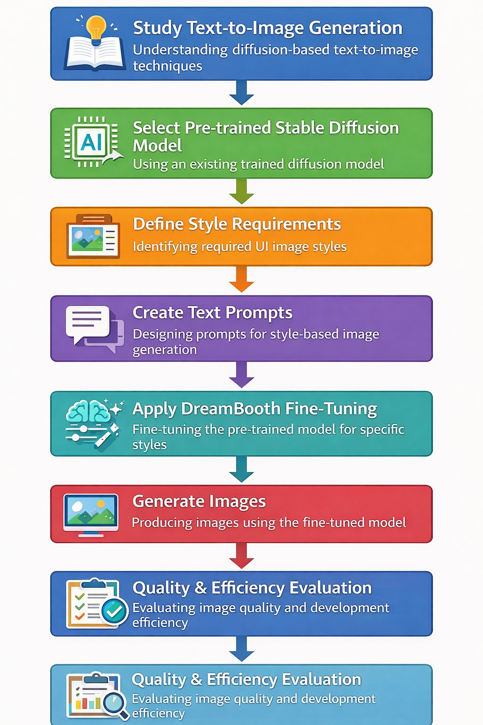
PLAN OF ACTION
Step-by-Step Plan :
• Text-to-Image Generation techniques and diffusion models are studied..
• Select Pre-trained Model A pre-trained Stable Diffusion model is selected.
• Define Style Requirements Required visual styles for the usability interface are identified.
• Create Text Prompts Style-specific text prompts are designed.
• Apply Dream Booth Fine-Tuning Dream Booth is applied to fine-tune the pre-trained model.
• Generate Images are generated using the fine-tuned model.
• Evaluate Results Generated images are evaluated for quality.

Slide 6
WORKFLOW
SOURCES :
Pre-trained Stable Diffusion models are used for text-to-image generation. The models are accessed and executed using cloud-based platforms without training from scratch.
Style-specific image generation is achieved by fine-tuning pre-trained models rather than building new datasets.
ALGORITHMS USED
Stable Diffusion (Pre-trained Model) A pre-trained diffusion-based deep learning model used for text-to-image generation. Converts textual prompts into high-quality images efficiently. Eliminates the need for training large datasets from scratch.
Dream Booth A fine-tuning technique applied on pre-trained Stable Diffusion models.Allows learning specific visual styles with minimal input images.Improves usability interface design while reducing cost and development time..

Slide 7
TECHNOLOGIES & EXTENSIVE LIBRARIES USED
TECHNOLOGIES USED :
Backend:
Python – Programming language used for implementing text-to-image generation logic.
Django – Web framework used to build the server and integrate image generation into the website.
Frontend:
HTML – Structure of the web pages.
CSS – Styling and layout of the pages.
JavaScript – Adds interactivity to the web pages.
EXTENSIVE LIBRARIES
Stable Diffusion – Pre-trained diffusion model used for text-to-image generation.
DreamBooth – Fine-tuning technique applied to adapt the pre-trained model for specific styles.
PyTorch – Deep learning framework used to run and fine-tune diffusion models.
Matplotlib – Used for visualization and analysis of generated images.

Slide 8
METHODS USED IN PROJECT
Text Prompt Design
Text prompts are carefully designed to describe the required image content and visual style.
Data Pre-trained Model Selection
A pre-trained Stable Diffusion model is selected to avoid training from scratch.
Dream Booth Fine-Tuning
Dream Booth technique is applied to fine-tune the pre-trained model for specific styles
Image Generation
Images are generated using the fine-tuned diffusion model based on user prompts.
Web Integration
The image generation process is integrated into a web application using Django.
Result Analysis
Generated images are reviewed to evaluate visual quality and usability interface suitability.

Slide 9
EVALUATION METRICS
Evaluation Metrics:
The realism of generated images is evaluated using qualitative visual inspection, ensuring that the images closely resemble professionally designed interface elements and meet usability requirements.

Slide 10
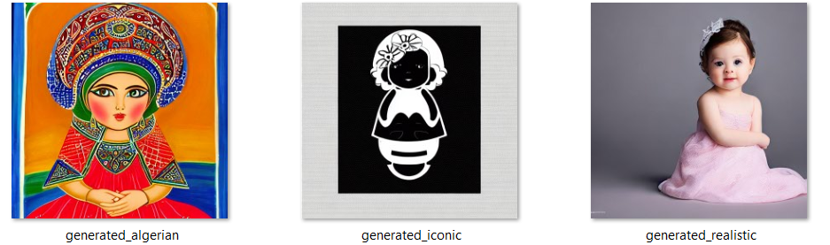
VISUALIZATIONS
Visualizations:
Displays images generated from text prompts to visually assess realism, clarity, and style consistency.

Slide 11
EXISTING VS PROPOSED METHODS
Existing Methods
Relied on manual illustration or third-party designers.
Required skilled artists and longer development time..
Increased development cost and dependency on external resources.
Proposed Method
Uses pre-trained Stable Diffusion with Dream Booth fine-tuning.
Generates images quickly using text prompts without manual drawing.
Reduces development time and overall cost significantly.
Produces high-quality, style-specific images for usability interfaces.
Can be easily integrated into web applications using Django.

Slide 12
CONCLUSION
The project shows how text-to-image generation using pre-trained Stable Diffusion and DreamBooth can be effectively used for usability interface development. By generating images directly from text prompts, we reduced manual design effort and dependency on external designers. The approach improves development efficiency while still producing realistic and visually consistent images. Overall, this project demonstrates the practical usefulness of AI-based image generation in modern web application development.
FUTURE ENHANCEMENT
The system can be extended to support more artistic styles for image generation.
Prompt optimization techniques can be added to improve image quality automatically.
The application can be enhanced to generate images in real time for dynamic web content.
Integration with additional web design tools can further improve usability interface development.

Slide 13
Thank You

